Slide 1


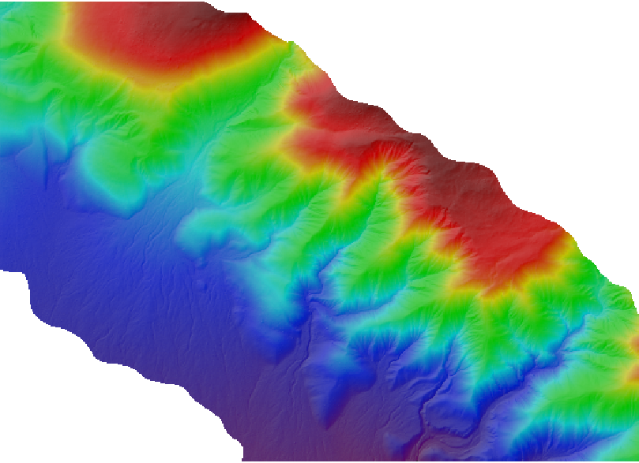
The Whitebox Geospatial Analysis Tools Project and Open-Access GIS
John Lindsay, Ph.D.
University of Guelph
January 15, 2016

Slide 2
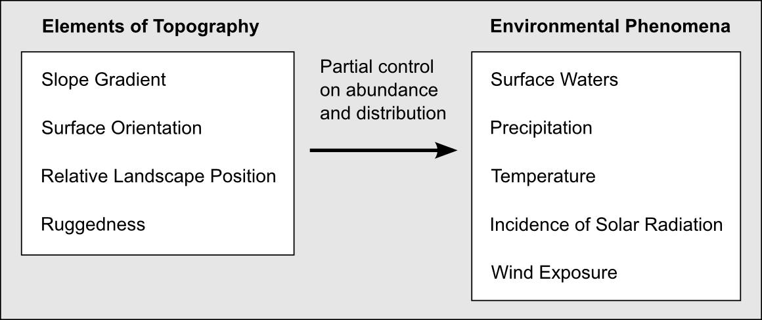

Slide 3
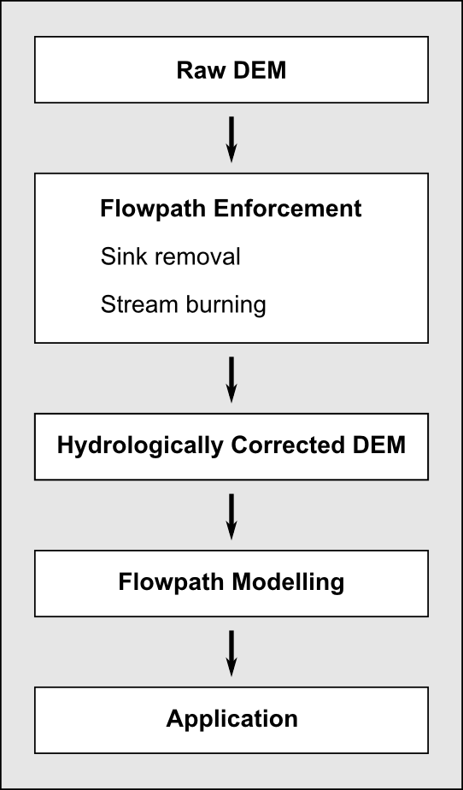

Slide 4
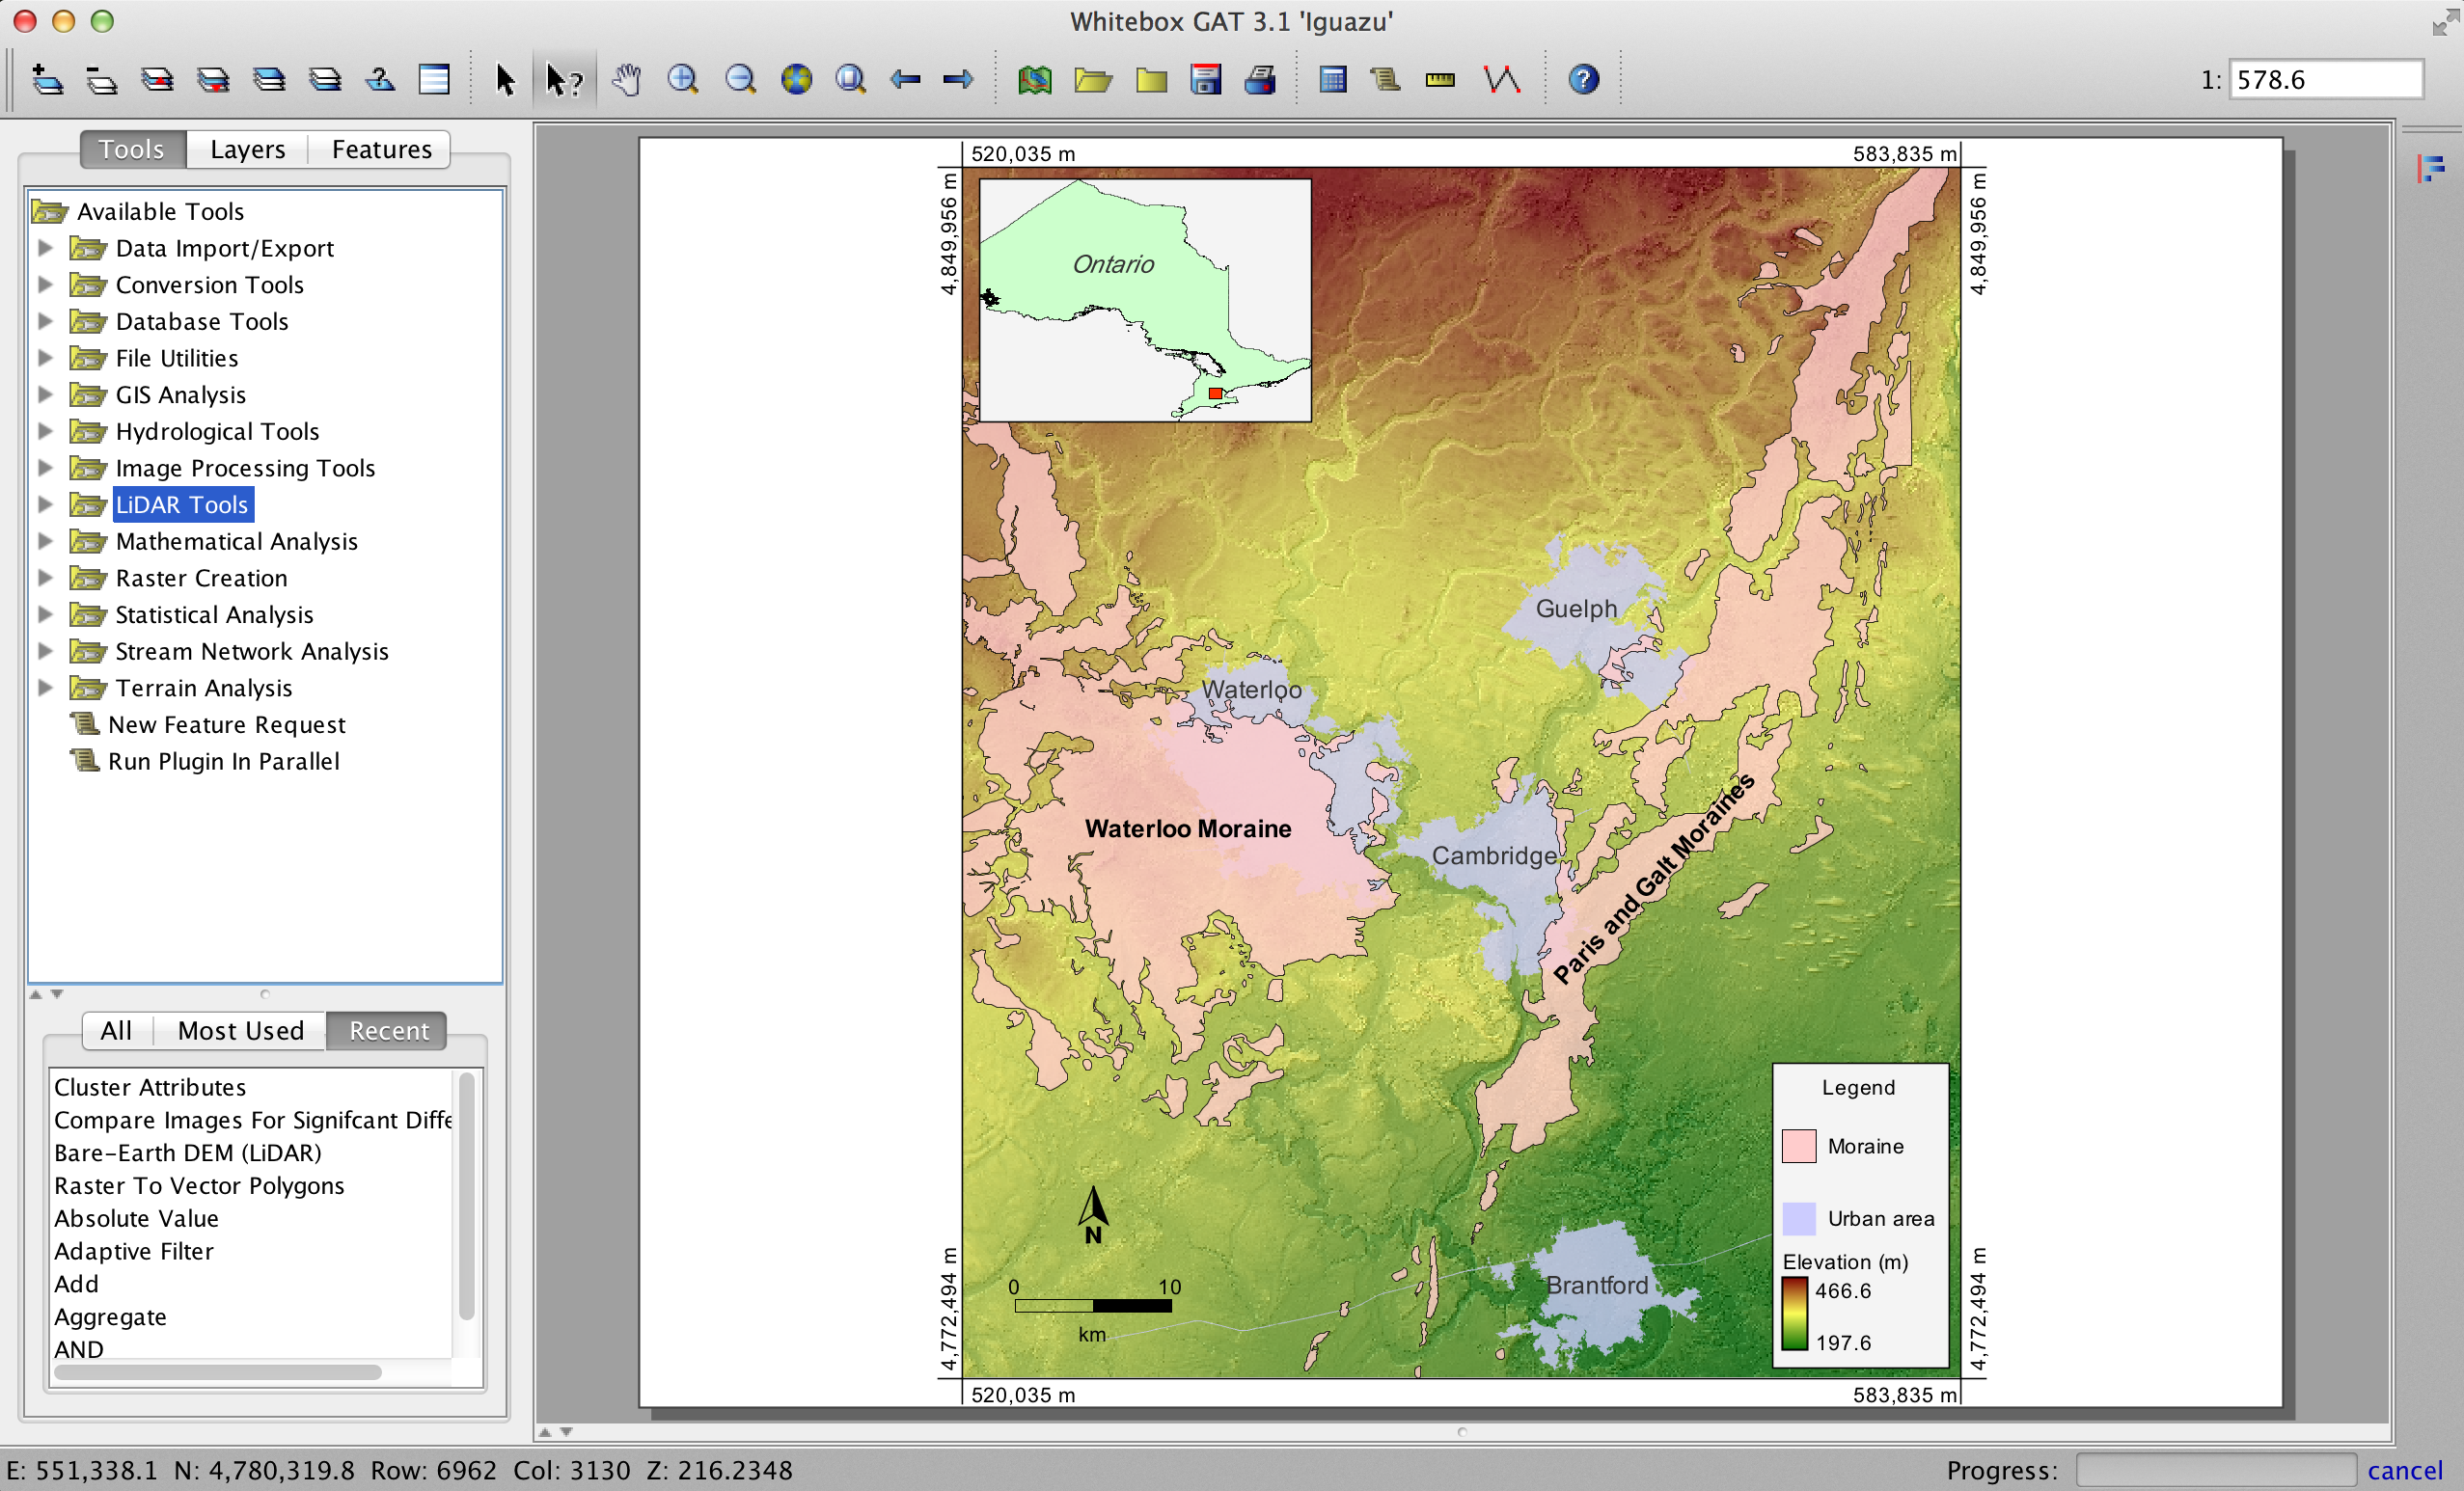
Whitebox GAT

Slide 5
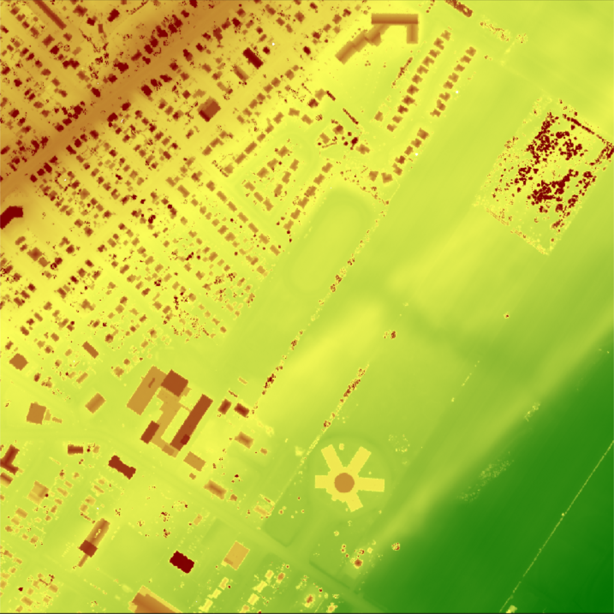
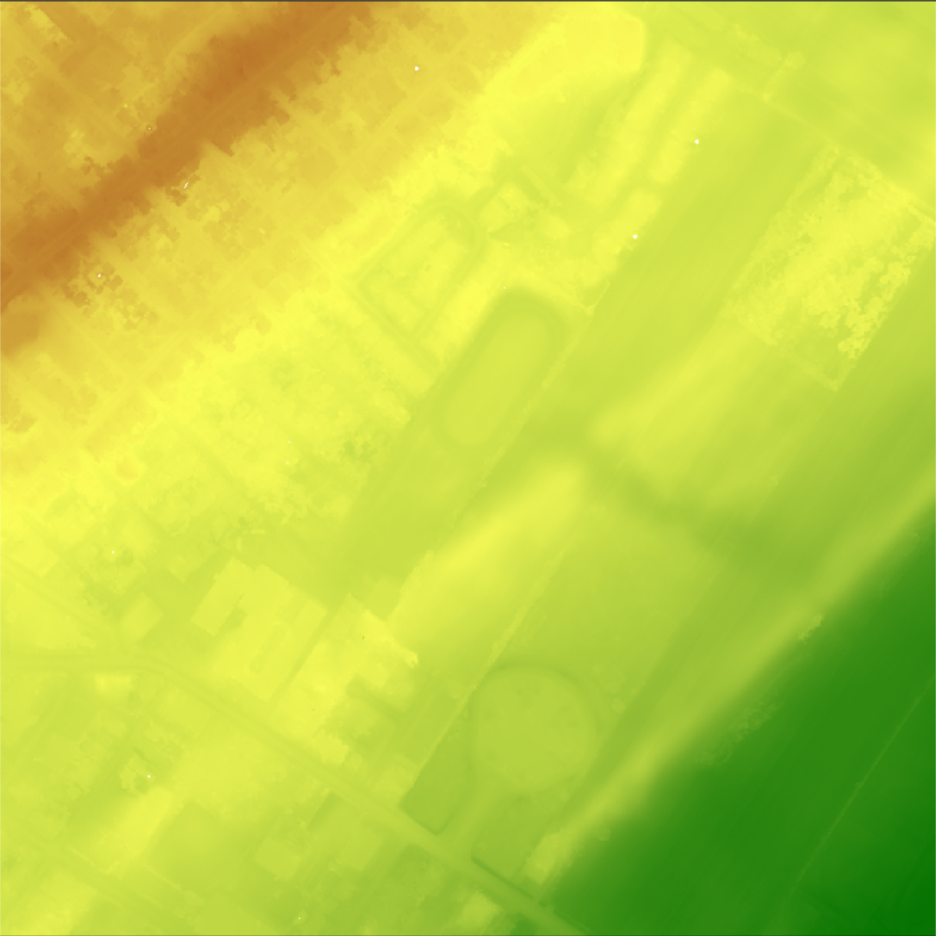
Removing Off-terrain Objects
Original last-return LiDAR DEM
Bare-Earth DEM created using ‘remove off-terrain objects’ tool

Slide 6
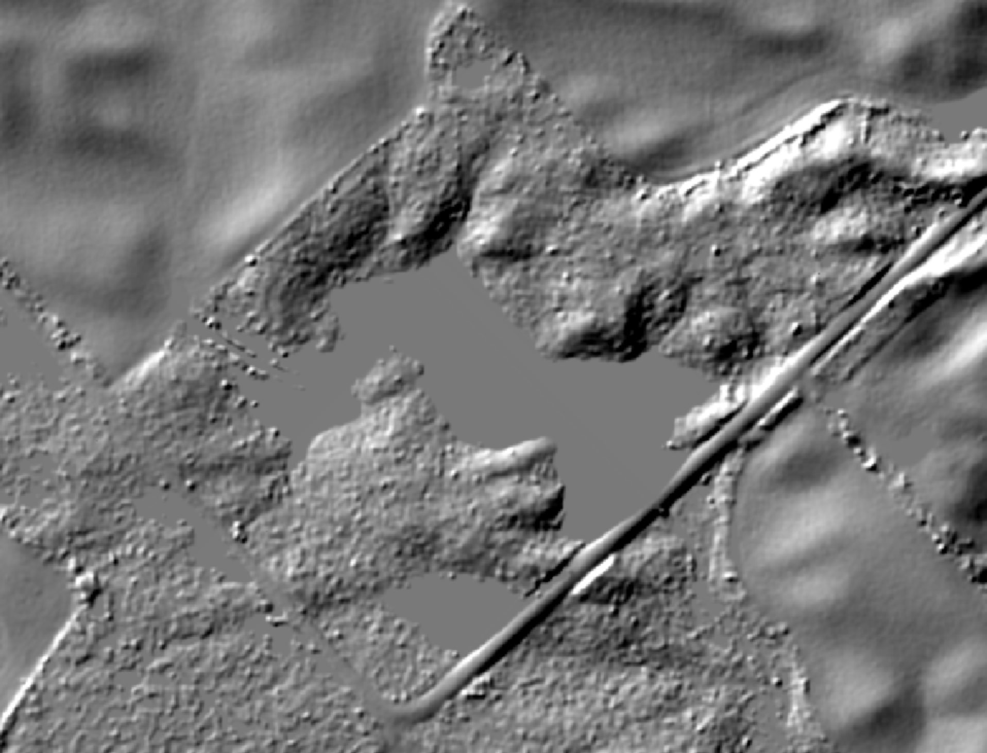
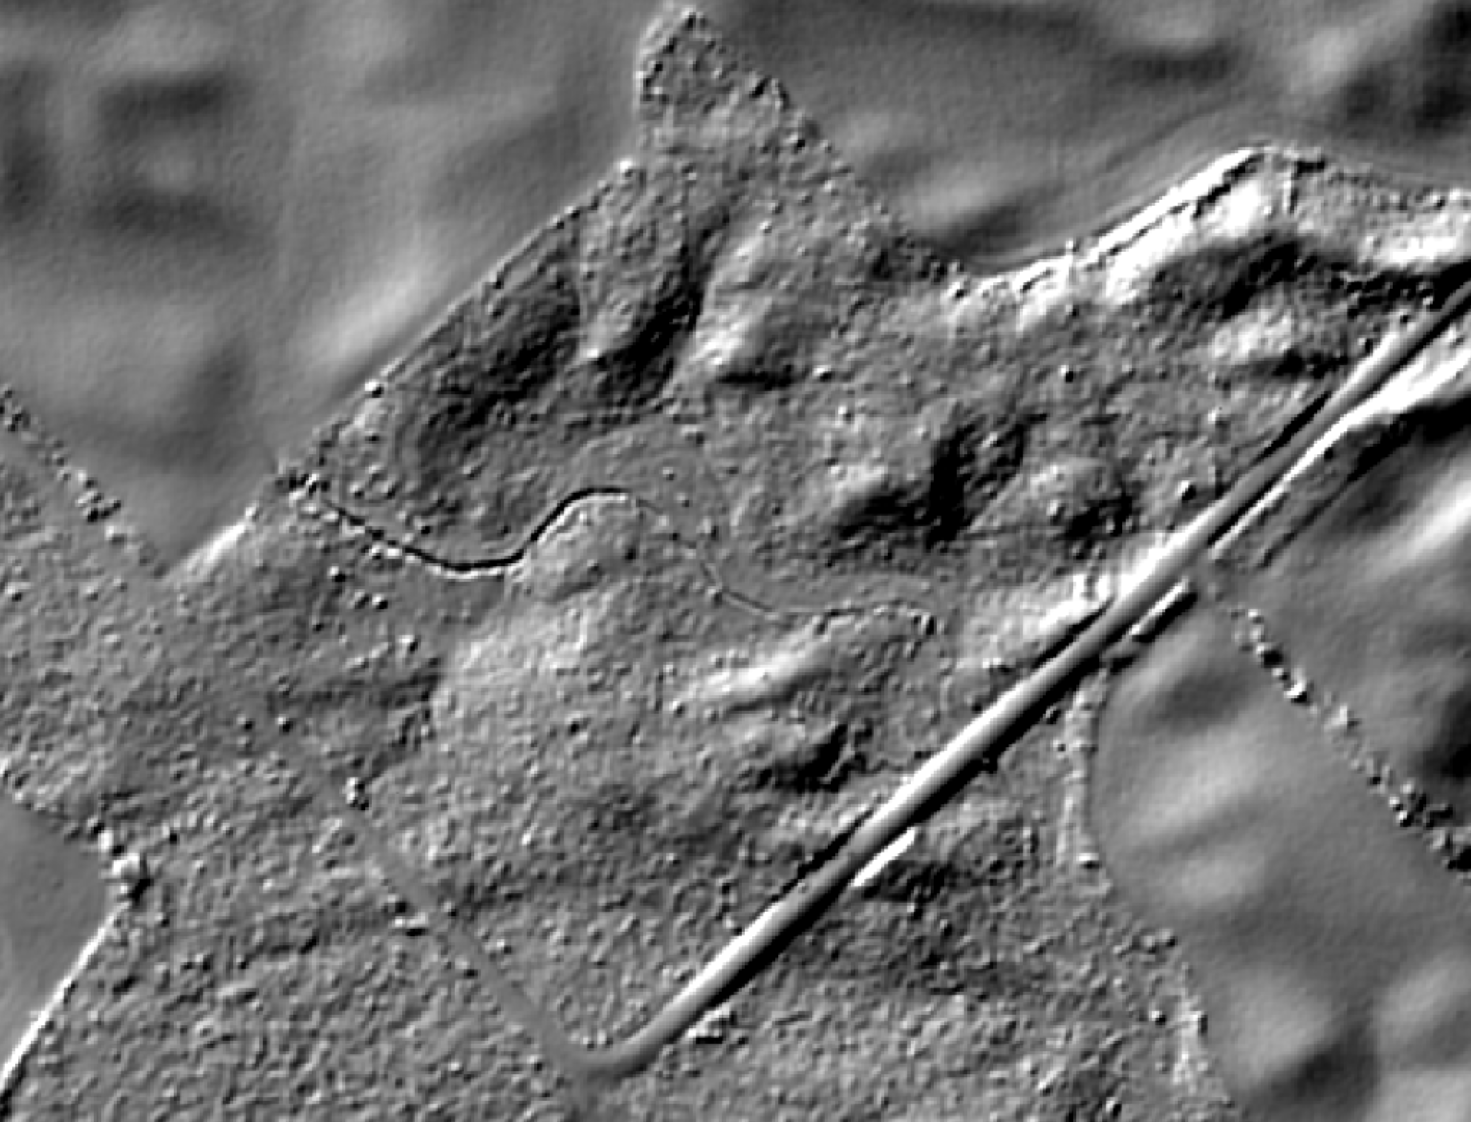
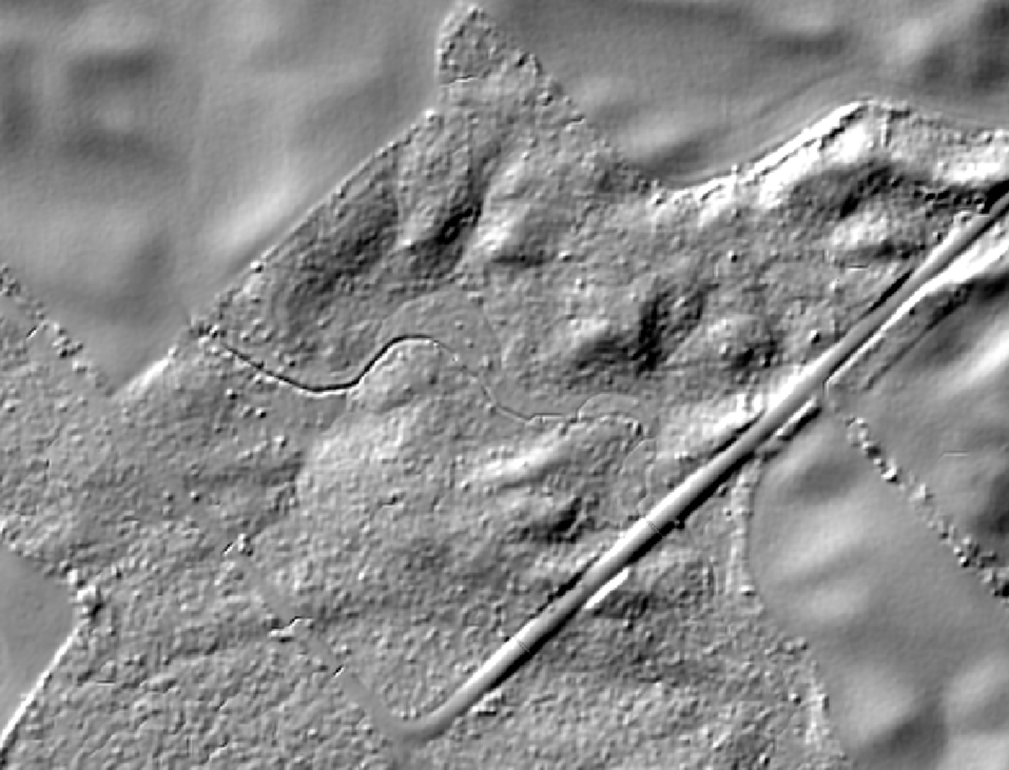
Surface Flow-path Enforcement
Depression Filling
Road blocks flow in DEM
X
X
Depression Breaching
Filling
Breaching

Slide 7
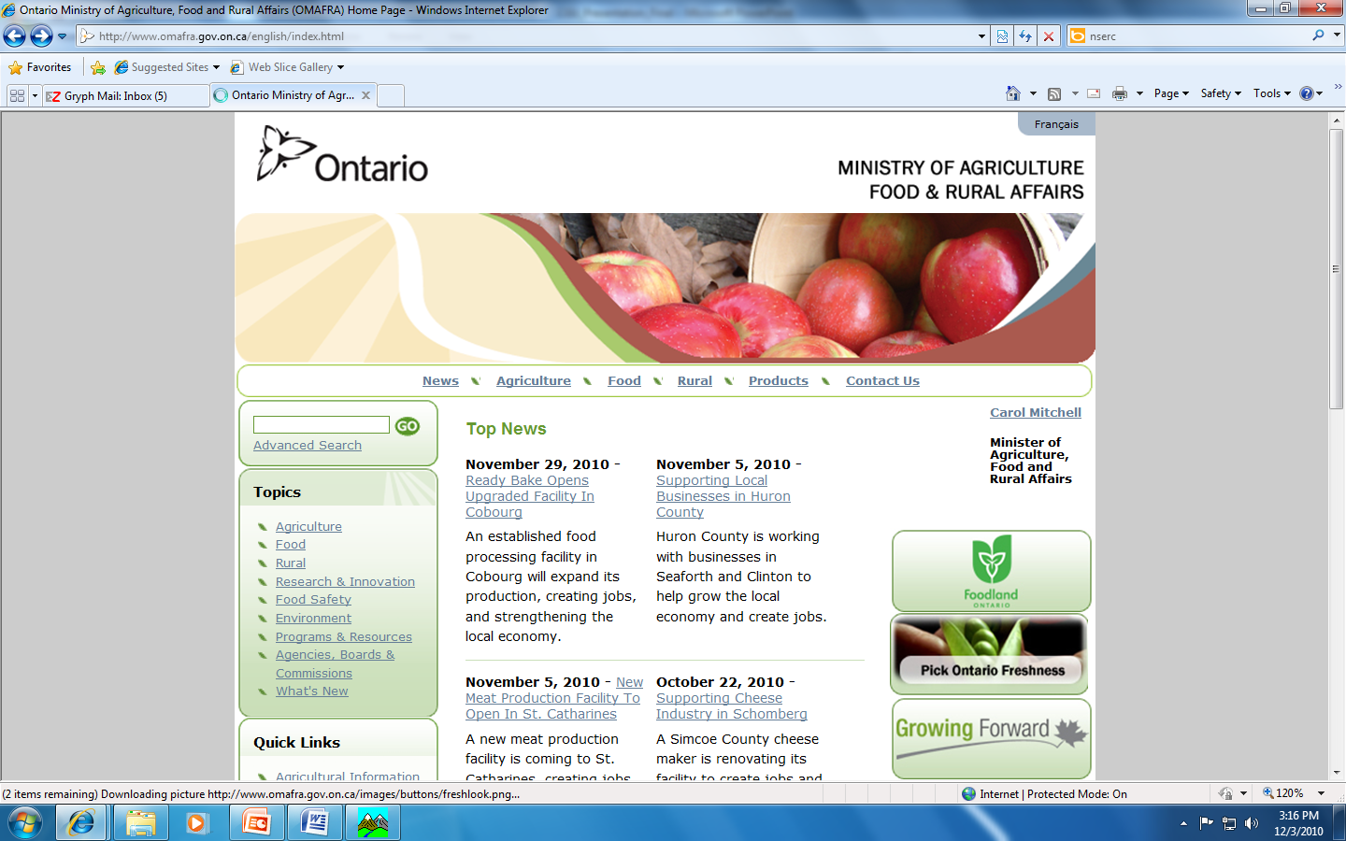

Acknowledgements
It’s been a wonderful honour to speak with you today.
Funding for this work has been provided by:

